Slide 1
Lecture 7: Hedonics, Voting with Your Feet, and Why it’s Not That Simple
Prof. Parthum
Environmental Economics Econ 475

Slide 2
The “Characteristics” Model
Lancaster (1966) –
A New Approach to Consumer Theory
The good, per se, does not give utility to the consumer; it possesses characteristics, and these characteristics give rise to utility.

Slide 3
The “Characteristics” Model
Lancaster (1966) –
A New Approach to Consumer Theory
The good, per se, does not give utility to the consumer; it possesses characteristics, and these characteristics give rise to utility.
In general, a good will possess more than one characteristic, and many characteristics will be shared by more than one good.

Slide 4
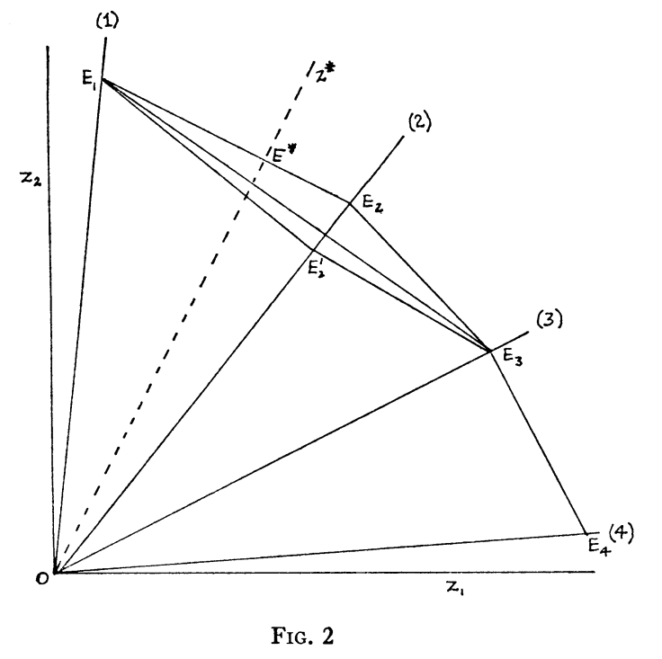
The “Characteristics” Model
Lancaster (1966) –
A New Approach to Consumer Theory
The good, per se, does not give utility to the consumer; it possesses characteristics, and these characteristics give rise to utility.
In general, a good will possess more than one characteristic, and many characteristics will be shared by more than one good.
Goods in combination may possess characteristics different from those pertaining to the goods separately.

Slide 5
Hedonic Price Theory
Rosen (1974) –
Hedonic Prices and Implicit Markets, Product Differentiation in Pure Competition
Products are objectively measured in characteristics

Slide 6
Hedonic Price Theory
Rosen (1974) –
Hedonic Prices and Implicit Markets, Product Differentiation in Pure Competition
Products are objectively measured in characteristics
Observed prices, combined with the set of characteristics, define a set of implicit or “hedonic” prices

Slide 7
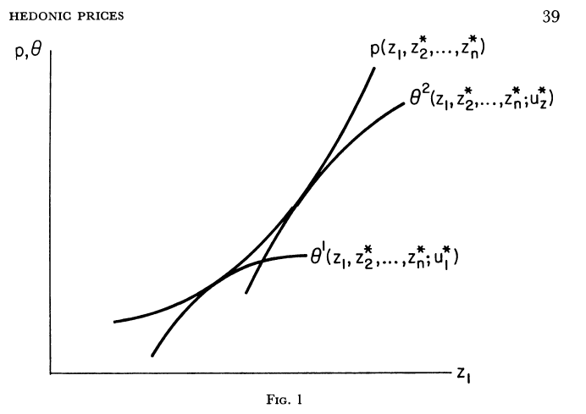
Hedonic Price Theory
Rosen (1974) –
Hedonic Prices and Implicit Markets, Product Differentiation in Pure Competition
Products are objectively measured in characteristics
Observed prices, combined with the set of characteristics, define a set of implicit or “hedonic” prices
This theory guides both producers and consumers in characteristics space

Slide 8
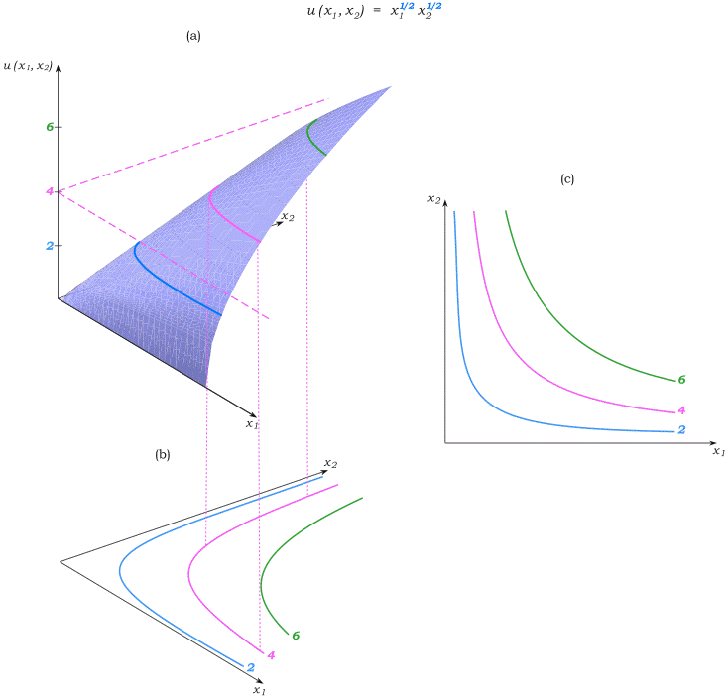
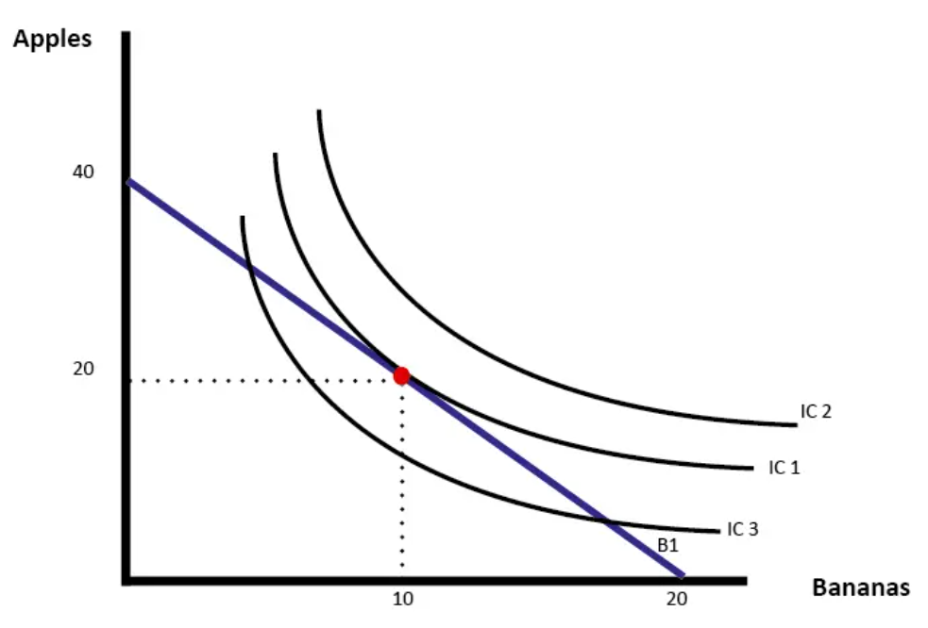
Aside: Level sets, utility, and attribute space

Slide 9




The Hedonic Price Model
$${Price}_{ijt}=βX+φ+ε_{ijt}$$
The housing market is a useful tool to estimate the value of nonmarket goods and services.

Slide 10
The Hedonic Price Model
$${Price}_{ijt}=βX+φ+ε_{ijt}$$
The housing market is a useful tool to estimate the value of nonmarket goods and services.
Can be a cross-section (e.g., one observation per home, or maybe one year, etc.) or panel (e.g., observe a home sell more than once, multiple years of data, etc.).

Slide 11
The Hedonic Price Model
$${Price}_{ijt}=βX+φ+ε_{ijt}$$
The housing market is a useful tool to estimate the value of nonmarket goods and services.
Can be a cross-section (e.g., one observation per home, or maybe one year, etc.) or panel (e.g., observe a home sell more than once, multiple years of data, etc.).
By incorporating distance to an amenity as a characteristic/attribute of the home, it’s possible to identify the relationship between home prices and the nonmarket amenity.

Slide 12

The Hedonic Price Model
$${Price}_{ijt}=βX+φ+ε_{ijt}$$
x 75
If we observe a home sell more than once, it can help control for unobservable characteristics of the home, neighborhood, etc.
x 50
x 90
x 30
x 100

Slide 13
The Hedonic Price Model
$${Price}_{ijt}=βX+φ+ε_{ijt}$$
x 75
If we observe a home sell more than once, it can help control for unobservable characteristics of the home, neighborhood, etc.
A panel of home sales can also offer an opportunity to exploit changes in environmental quality or quantity (intensive margin).
x 50
x 90
x 30
x 100

Slide 14
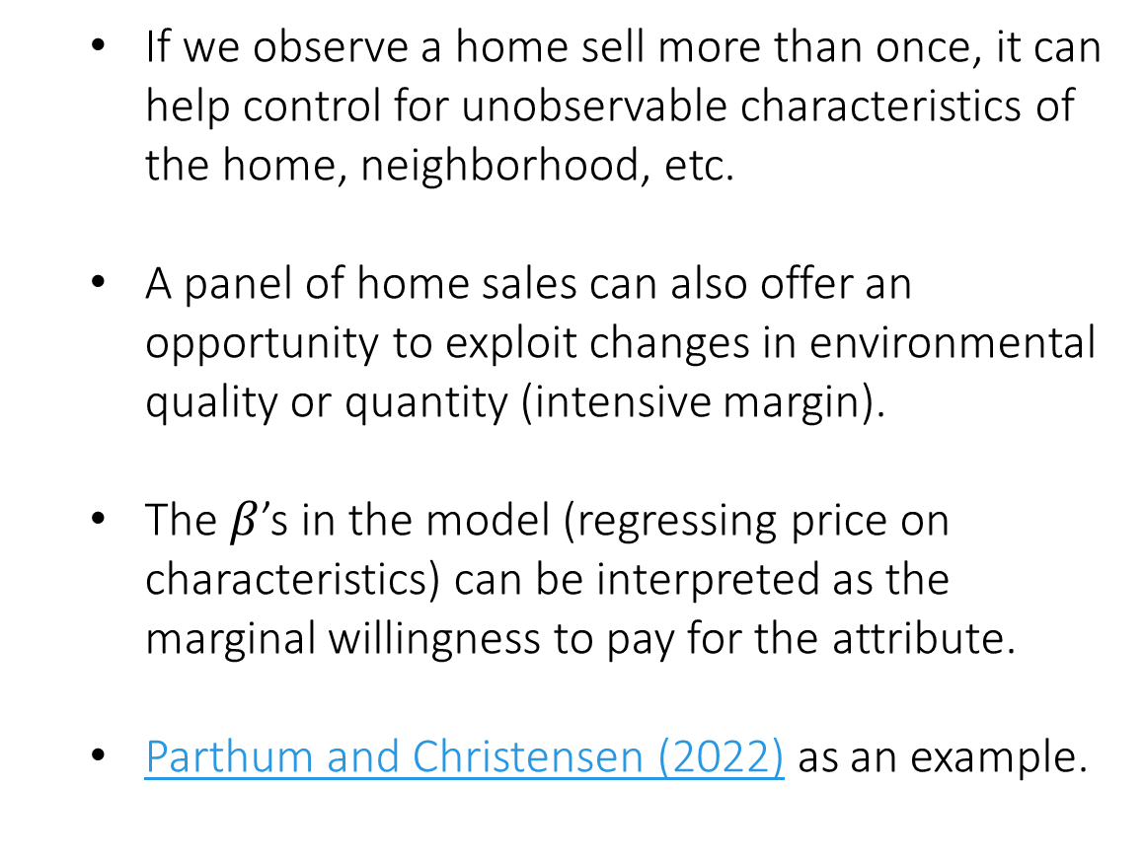
The Hedonic Price Model
$${Price}_{ijt}=βX+φ+ε_{ijt}$$
x 75
If we observe a home sell more than once, it can help control for unobservable characteristics of the home, neighborhood, etc.
A panel of home sales can also offer an opportunity to exploit changes in environmental quality or quantity (intensive margin).
The $β$’s in the model (regressing price on characteristics) can be interpreted as the marginal willingness to pay for the attribute.
Parthum and Christensen (2022) as an example.
x 50
x 90
x 30
x 100

Slide 15
A more comprehensive estimate of the value of water quality(here)
By: Kuwayama et al. (2022)
Research Questions:
What is the value of changes to water quality in Tampa Bay, Florida?
Approximately $13.70 per trip for
Do conventional hedonic estimates misestimate values, and can incorporating a travel cost model improve benefits estimation?
They find evidence that using conventional methods could potentially understate the value of the regional park.

Slide 16
A more comprehensive estimate of the value of water quality(here)
By: Kuwayama et al. (2022)
Research Questions:
What is the value of changes to water quality in Tampa Bay, Florida?
$454-$980 per household, $366m-$789m in the metro area per year
Approximately $13.70 per trip for
Do conventional hedonic estimates misestimate values, and can incorporating a travel cost model improve benefits estimation?
The authors argue that their two-stage estimation procedure, that explicitly incorporates the recreation demand model into their hedonic estimation, significantly improves the welfare estimates of changes in water quality in the Tampa Bay area. the value of the regional park.

Slide 17
A more comprehensive estimate of the value of water quality(here)
By: Kuwayama et al. (2022)
Data:
146k home sales between 1998 and 2014
Time series of water quality data, namely dissolved oxygen
Fishing survey data from the Marine Recreational Fisheries Statistics Survey (MRFSS) and the Marine Recreational Information Program (MRIP) the value of the regional park.

Slide 18
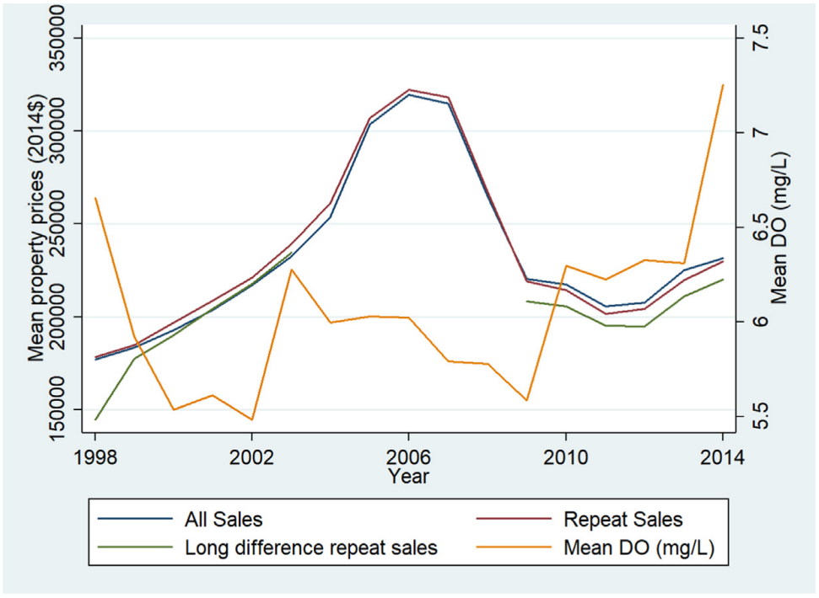
The Data

Slide 19
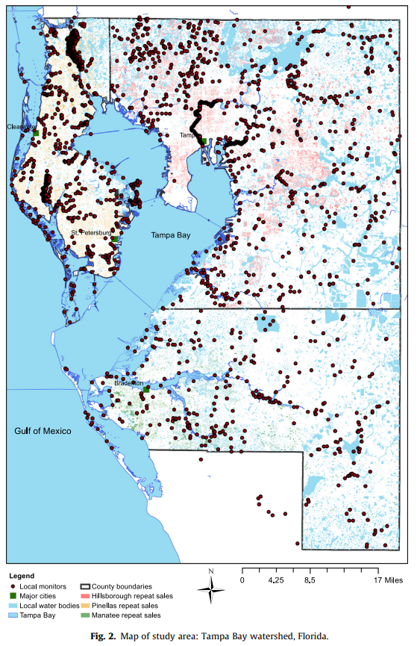

The Problem

Slide 20
The Problem

Slide 21

The Problem

Slide 22
The two-stage model
$${\log\left(price\right)}_{ijt}=β_{0}+β_{1}Age_{it}+β_{2}{\log\left(WQ\right)}_{it}+β_{3}{\hat{ECS}}_{jt}+α_{i}+γ_{t}+ω_{m}+ε_{ijt}$$

Slide 23
The two-stage model
$${\log\left(price\right)}_{ijt}=β_{0}+β_{1}Age_{it}+β_{2}{\log\left(WQ\right)}_{it}+β_{3}{\hat{ECS}}_{jt}+α_{i}+γ_{t}+ω_{m}+ε_{ijt}$$

Slide 24
The two-stage model
$${\log\left(price\right)}_{ijt}=β_{0}+β_{1}Age_{it}+β_{2}{\log\left(WQ\right)}_{it}+β_{3}{\hat{ECS}}_{jt}+α_{i}+γ_{t}+ω_{m}+ε_{ijt}$$

Slide 25
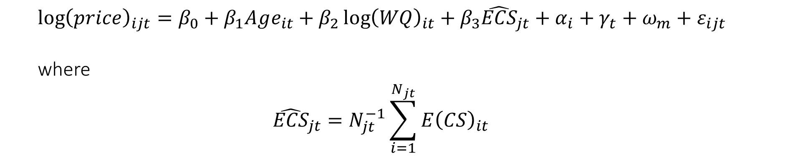
The two-stage model
$${\log\left(price\right)}_{ijt}=β_{0}+β_{1}Age_{it}+β_{2}{\log\left(WQ\right)}_{it}+β_{3}{\hat{ECS}}_{jt}+α_{i}+γ_{t}+ω_{m}+ε_{ijt}$$
where
$${\hat{ECS}}_{jt}=N_{jt}^{−1}\sum_{i=1}^{N_{jt}}{E{\left(CS\right)}_{it}}$$

Slide 26
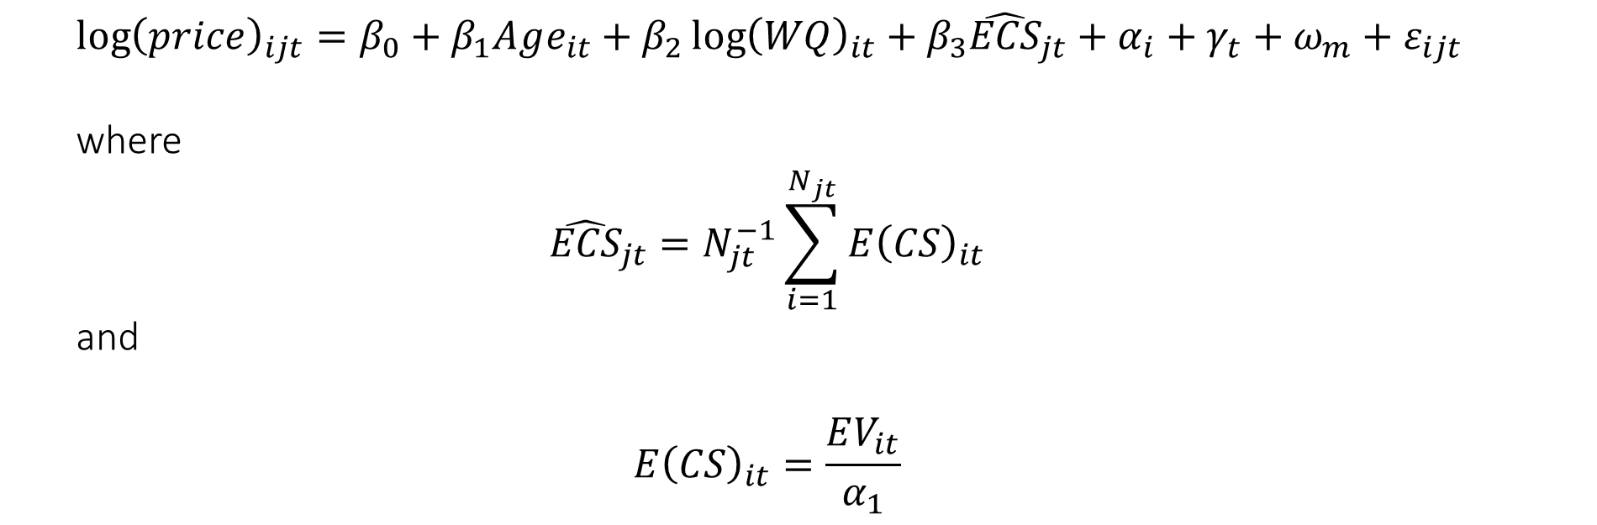
The two-stage model
$${\log\left(price\right)}_{ijt}=β_{0}+β_{1}Age_{it}+β_{2}{\log\left(WQ\right)}_{it}+β_{3}{\hat{ECS}}_{jt}+α_{i}+γ_{t}+ω_{m}+ε_{ijt}$$
where
$${\hat{ECS}}_{jt}=N_{jt}^{−1}\sum_{i=1}^{N_{jt}}{E{\left(CS\right)}_{it}}$$
and
$$E{\left(CS\right)}_{it}=\frac{EV_{it}}{α_{1}}$$

Slide 27

The two-stage model
$${\log\left(price\right)}_{ijt}=β_{0}+β_{1}Age_{it}+β_{2}{\log\left(WQ\right)}_{it}+β_{3}{\hat{ECS}}_{jt}+α_{i}+γ_{t}+ω_{m}+ε_{ijt}$$
where
$${\hat{ECS}}_{jt}=N_{jt}^{−1}\sum_{i=1}^{N_{jt}}{E{\left(CS\right)}_{it}}$$
and
$$E{\left(CS\right)}_{it}=\frac{EV_{it}}{α_{1}}$$
and
$$EV_{it}=\log\left(\sum_{k=1}^{K}{\exp\left({\hat{V}}_{ikt}\right)}\right)$$

Slide 28
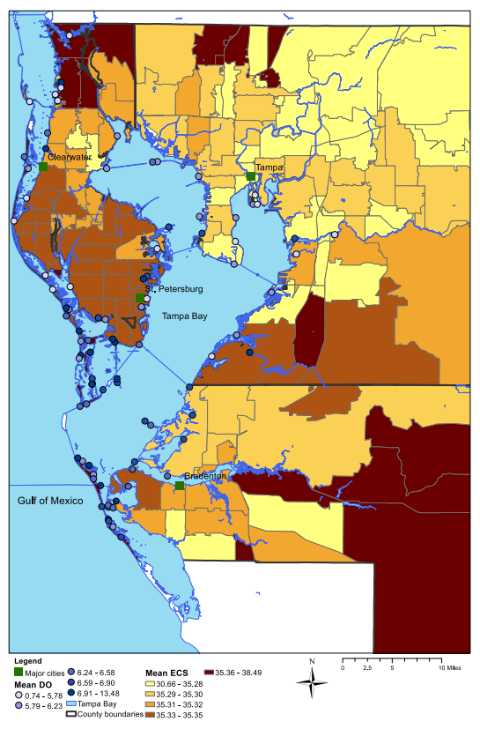
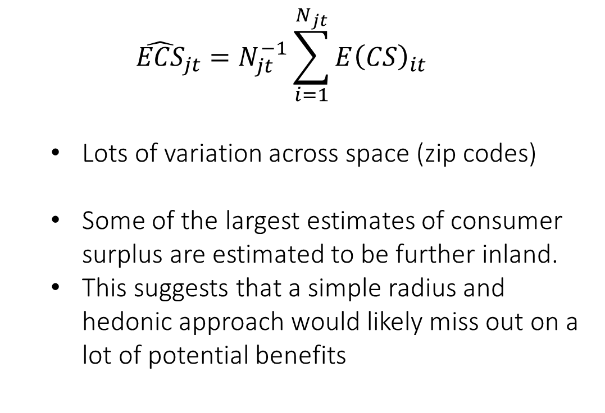
$${\hat{ECS}}_{jt}=N_{jt}^{−1}\sum_{i=1}^{N_{jt}}{E{\left(CS\right)}_{it}}$$
Lots of variation across space (zip codes)
Some of the largest estimates of consumer surplus are estimated to be further inland.
This suggests that a simple radius and hedonic approach would likely miss out on a lot of potential benefits

Slide 29
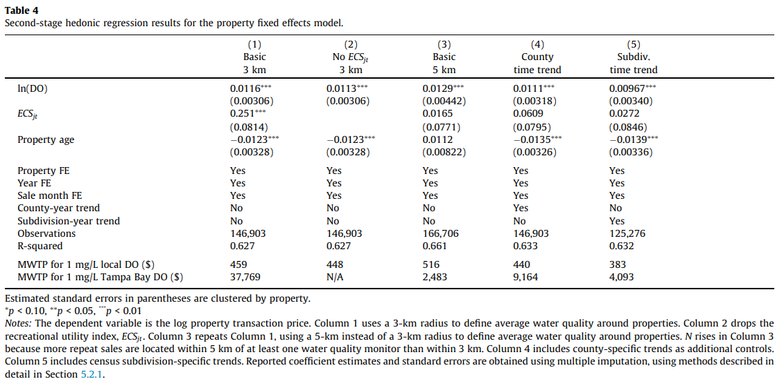
$${\log\left(price\right)}_{ijt}=β_{0}+β_{1}Age_{it}+β_{2}{\log\left(WQ\right)}_{it}+β_{3}{\hat{ECS}}_{jt}+α_{i}+γ_{t}+ω_{m}+ε_{ijt}$$

Slide 30
$${\log\left(price\right)}_{ijt}=β_{0}+β_{1}Age_{it}+β_{2}{\log\left(WQ\right)}_{it}+β_{3}{\hat{ECS}}_{jt}+α_{i}+γ_{t}+ω_{m}+ε_{ijt}$$

Slide 31
Careful exploration of potential confounders:
“One caveat of our property transaction data is that we do not observe changes in property characteristics over time (except age, which we construct from the year each home was built). If the likelihood of renovation is correlated with either local water quality improvements or the recreational benefits of regional water quality improvements, this omission could bias our estimates (Billings, 2015). If households substitute structural improvements for neighborhood quality, this bias would be negative. If neighborhood quality spurs home improvements (for example, if water quality improvements lead to gentrification), the bias would be upward. Incorporating renovation information, for example from residential construction permitting data, into hedonic analyses that value environmental amenities is an important area for future work.”

Slide 32
Careful exploration of potential confounders:
“One caveat of our property transaction data is that we do not observe changes in property characteristics over time (except age, which we construct from the year each home was built). If the likelihood of renovation is correlated with either local water quality improvements or the recreational benefits of regional water quality improvements, this omission could bias our estimates (Billings, 2015). If households substitute structural improvements for neighborhood quality, this bias would be negative. If neighborhood quality spurs home improvements (for example, if water quality improvements lead to gentrification), the bias would be upward. Incorporating renovation information, for example from residential construction permitting data, into hedonic analyses that value environmental amenities is an important area for future work.”

Slide 33
Careful exploration of potential confounders:
“One caveat of our property transaction data is that we do not observe changes in property characteristics over time (except age, which we construct from the year each home was built). If the likelihood of renovation is correlated with either local water quality improvements or the recreational benefits of regional water quality improvements, this omission could bias our estimates (Billings, 2015). If households substitute structural improvements for neighborhood quality, this bias would be negative. If neighborhood quality spurs home improvements (for example, if water quality improvements lead to gentrification), the bias would be upward. Incorporating renovation information, for example from residential construction permitting data, into hedonic analyses that value environmental amenities is an important area for future work.”

Slide 34
Sorting or Steering: The effects of housing discrimination on neighborhood choice (here)
By: Christensen and Timmins (NBER 2022)
Research Questions:
Can people simply “vote with their feet”?
They find evidence that using conventional methods could potentially understate the value of the regional park.

Slide 35
Sorting or Steering: The effects of housing discrimination on neighborhood choice (here)
By: Christensen and Timmins (NBER 2022)
Growing evidence indicates that neighborhoods affect human capital accumulation, raising concern that the exclusionary effects of housing discrimination could contribute to persistent inequality. Using data from HUD's most recent Housing Discrimination Study and micro-level data on key attributes of neighborhoods in 28 US cities, we find strong evidence that discrimination constrains the neighborhood choices of minorities in a housing search. Minority testers are significantly more likely to be steered towards neighborhoods with lower quality schools and neighborhood human capital, and higher rates of assault and pollution exposure. Holding location preferences and income constant, discriminatory steering alone can explain a disproportionate number of minority households found in high poverty neighborhoods in the United States and could contribute to racial gaps in inter- generational income mobility. These results have important implications for the analysis of neighborhood effects and further establish discrimination as a mechanism underlying observed correlations between race and pollution exposures.

Slide 36
Sorting or Steering: The effects of housing discrimination on neighborhood choice (here)
By: Christensen and Timmins (NBER 2022)
Growing evidence indicates that neighborhoods affect human capital accumulation, raising concern that the exclusionary effects of housing discrimination could contribute to persistent inequality. Using data from HUD's most recent Housing Discrimination Study and micro-level data on key attributes of neighborhoods in 28 US cities, we find strong evidence that discrimination constrains the neighborhood choices of minorities in a housing search. Minority testers are significantly more likely to be steered towards neighborhoods with lower quality schools and neighborhood human capital, and higher rates of assault and pollution exposure. Holding location preferences and income constant, discriminatory steering alone can explain a disproportionate number of minority households found in high poverty neighborhoods in the United States and could contribute to racial gaps in inter- generational income mobility. These results have important implications for the analysis of neighborhood effects and further establish discrimination as a mechanism underlying observed correlations between race and pollution exposures.

Slide 37
Sorting or Steering: The effects of housing discrimination on neighborhood choice (here)
By: Christensen and Timmins (NBER 2022)
Growing evidence indicates that neighborhoods affect human capital accumulation, raising concern that the exclusionary effects of housing discrimination could contribute to persistent inequality. Using data from HUD's most recent Housing Discrimination Study and micro-level data on key attributes of neighborhoods in 28 US cities, we find strong evidence that discrimination constrains the neighborhood choices of minorities in a housing search. Minority testers are significantly more likely to be steered towards neighborhoods with lower quality schools and neighborhood human capital, and higher rates of assault and pollution exposure. Holding location preferences and income constant, discriminatory steering alone can explain a disproportionate number of minority households found in high poverty neighborhoods in the United States and could contribute to racial gaps in inter- generational income mobility. These results have important implications for the analysis of neighborhood effects and further establish discrimination as a mechanism underlying observed correlations between race and pollution exposures.

Slide 38
Sorting or Steering: The effects of housing discrimination on neighborhood choice (here)
By: Christensen and Timmins (NBER 2022)
Growing evidence indicates that neighborhoods affect human capital accumulation, raising concern that the exclusionary effects of housing discrimination could contribute to persistent inequality. Using data from HUD's most recent Housing Discrimination Study and micro-level data on key attributes of neighborhoods in 28 US cities, we find strong evidence that discrimination constrains the neighborhood choices of minorities in a housing search. Minority testers are significantly more likely to be steered towards neighborhoods with lower quality schools and neighborhood human capital, and higher rates of assault and pollution exposure. Holding location preferences and income constant, discriminatory steering alone can explain a disproportionate number of minority households found in high poverty neighborhoods in the United States and could contribute to racial gaps in inter- generational income mobility. These results have important implications for the analysis of neighborhood effects and further establish discrimination as a mechanism underlying observed correlations between race and pollution exposures.

Slide 39
Sorting or Steering: The effects of housing discrimination on neighborhood choice (here)
By: Christensen and Timmins (NBER 2022)
Growing evidence indicates that neighborhoods affect human capital accumulation, raising concern that the exclusionary effects of housing discrimination could contribute to persistent inequality. Using data from HUD's most recent Housing Discrimination Study and micro-level data on key attributes of neighborhoods in 28 US cities, we find strong evidence that discrimination constrains the neighborhood choices of minorities in a housing search. Minority testers are significantly more likely to be steered towards neighborhoods with lower quality schools and neighborhood human capital, and higher rates of assault and pollution exposure. Holding location preferences and income constant, discriminatory steering alone can explain a disproportionate number of minority households found in high poverty neighborhoods in the United States and could contribute to racial gaps in inter- generational income mobility. These results have important implications for the analysis of neighborhood effects and further establish discrimination as a mechanism underlying observed correlations between race and pollution exposures.

Slide 40
Sorting or Steering: The effects of housing discrimination on neighborhood choice (here)
By: Christensen and Timmins (NBER 2022)
Growing evidence indicates that neighborhoods affect human capital accumulation, raising concern that the exclusionary effects of housing discrimination could contribute to persistent inequality. Using data from HUD's most recent Housing Discrimination Study and micro-level data on key attributes of neighborhoods in 28 US cities, we find strong evidence that discrimination constrains the neighborhood choices of minorities in a housing search. Minority testers are significantly more likely to be steered towards neighborhoods with lower quality schools and neighborhood human capital, and higher rates of assault and pollution exposure. Holding location preferences and income constant, discriminatory steering alone can explain a disproportionate number of minority households found in high poverty neighborhoods in the United States and could contribute to racial gaps in inter- generational income mobility. These results have important implications for the analysis of neighborhood effects and further establish discrimination as a mechanism underlying observed correlations between race and pollution exposures.

Slide 41
Next class
Stated Preferences and Hypothetical Markets:
Parthum and Ando (2020)
I chose this paper not because it is one of mine, but because I think I did a better job than most at walking through the intuition of the approach and various assumptions along the way.
September 26th
Estimating the relationship between climate and the economy
We are going to hear about some of the work Yagmur (one of your amazing TA’s) is doing in this realm!

